Slide 1

Graphically, the increase in t is the opposite case of slide 23 in the second set of slides (which showed an increase w)
$$C=w\left(1−t\right)h −w\left(1−t\right)l+ π$$

Slide 2
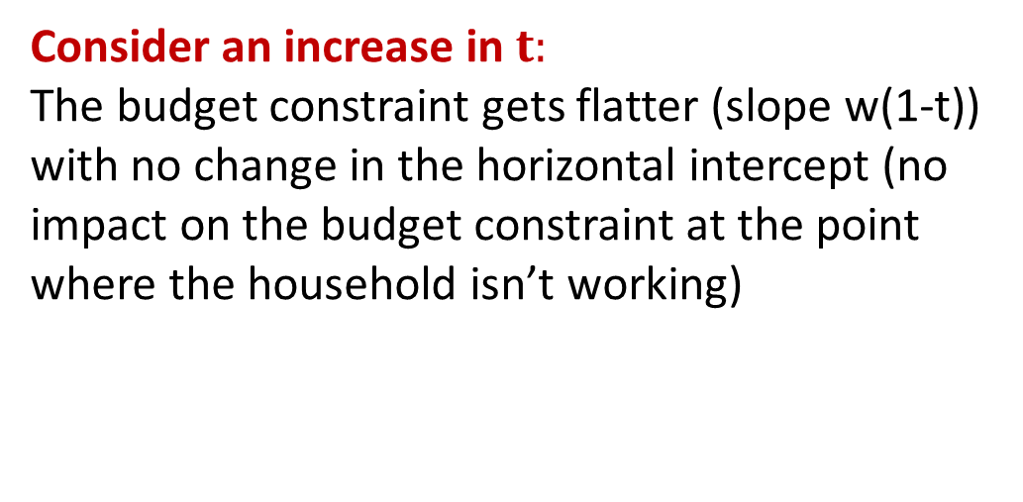
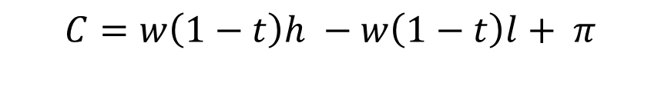

$$C=w\left(1−t\right)h −w\left(1−t\right)l+ π$$
Case where $π>T$
C
Consider an increase in $t:$
The budget constraint gets flatter (slope w(1-t)) with no change in the horizontal intercept (no impact on the budget constraint at the point where the household isn’t working)
C1
A
IC(1)
l1
l

Slide 3
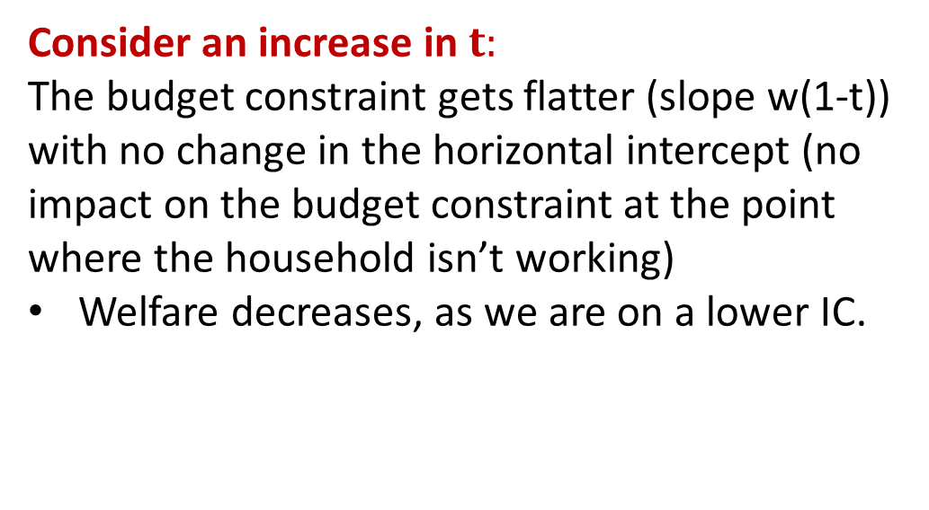

$$C=w\left(1−t\right)h −w\left(1−t\right)l+ π$$
Case where $π>T$
C
Consider an increase in $t:$
The budget constraint gets flatter (slope w(1-t)) with no change in the horizontal intercept (no impact on the budget constraint at the point where the household isn’t working)
Welfare decreases, as we are on a lower IC.
>
A
C1
IC(1)
IC(2)
l1
l

Slide 4
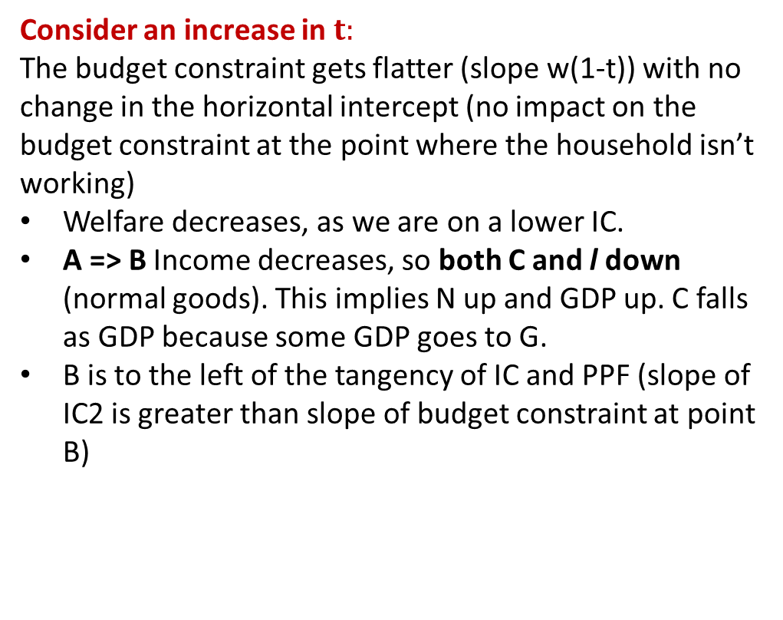

$$C=w\left(1−t\right)h −w\left(1−t\right)l+ π$$
Case where $π>T$
C
Consider an increase in $t:$
The budget constraint gets flatter (slope w(1-t)) with no change in the horizontal intercept (no impact on the budget constraint at the point where the household isn’t working)
Welfare decreases, as we are on a lower IC.
A => B Income decreases, so both C and l down (normal goods). This implies N up and GDP up. C falls as GDP because some GDP goes to G.
B is to the left of the tangency of IC and PPF (slope of IC2 is greater than slope of budget constraint at point B)
>
.
A
C1
B
IC(2)
IC(1)
l1
l

Slide 5
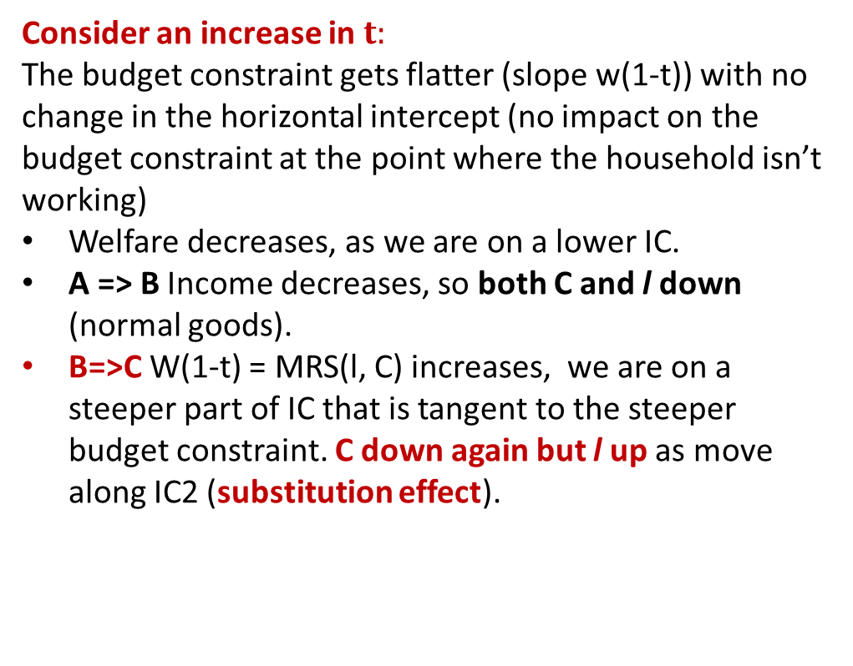

$$C=w\left(1−t\right)h −w\left(1−t\right)l+ π$$
Case where $π>T$
C
Consider an increase in $t:$
The budget constraint gets flatter (slope w(1-t)) with no change in the horizontal intercept (no impact on the budget constraint at the point where the household isn’t working)
Welfare decreases, as we are on a lower IC.
A => B Income decreases, so both C and l down (normal goods).
B=>C W(1-t) = MRS(l, C) increases, we are on a steeper part of IC that is tangent to the steeper budget constraint. C down again but l up as move along IC2 (substitution effect).
>
.
.
.
A
C1
B
C2
C
IC(1)
IC(2)
l2
l1
l

Slide 6

$$C=w\left(1−t\right)h −w\left(1−t\right)l+ π$$
Case where $π>T$
C
Consider an increase in $t:$
The budget constraint gets flatter (slope w(1-t)) with no change in the horizontal intercept (no impact on the budget constraint at the point where the household isn’t working)
Welfare decreases, as we are on a lower IC.
A => B Income decreases, so both C and l down (normal goods).
B=>C W(1-t) = MRS(l, C) increases, we are on a steeper part of IC that is tangent to the steeper budget constraint. C down again but l up as move along IC2 (substitution effect).
>
.
.
.
A
C1
B
C2
C
IC(1)
As drawn, leisure decreased and N and GDP went up, but in general the change in leisure/labor and GDP is ambiguous because the income and substitution effects influence leisure in opposite directions. The increase in C however is unambiguous.
IC(2)
l2
l1
l

